Slide 1
Squishy Soapy Jello Gels in Nano Size Molds
Research Work Presented by:
Mr. Mark Oliver
Mr. Ryan Cates

Slide 2
Mr. Oliver’s Science Meddlings
MEMS (Micro Electro Mechanical Systems
  Clean Room Operations
    Piranha Cleaning “Squeaky Cleaning”
    Photo lithography “Mold Making”
  Interest in Nano Technology
    Nano for Noobies web page
      Nano science behind kale, etc..
      Nano paws of geckos
      Nano-Tex Textiles

Slide 3
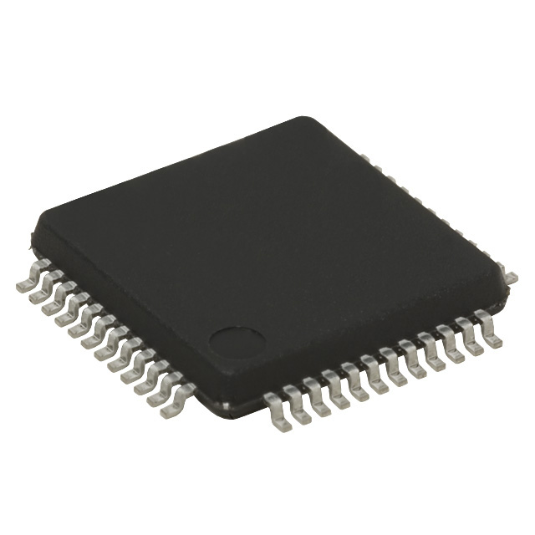
MEMS
Micro –Small
Electro –Electronics
Mechanical – Machinery
Systems –Groups of Machinery
“Small groups of electrically powered machinery”

Slide 4
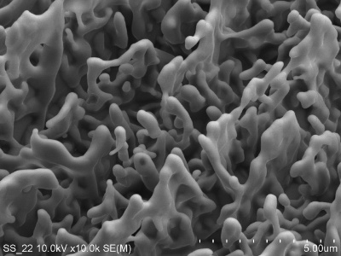
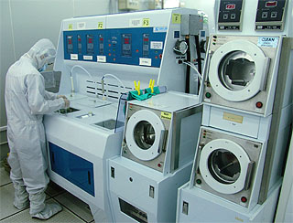
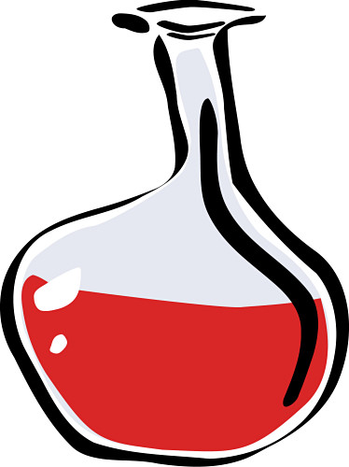
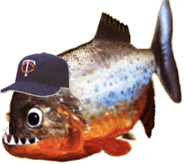
Making MEMS in a clean room
Cleaning Wafers (Si not Nabisco)
Piranha – Hydrogen Peroxide and Sulfuric Acid
  Really strong washing solution that will remove dirt and oil from very small holes in the surface of Silicon.
  Regular soap or solvents can’t do this!

Slide 5
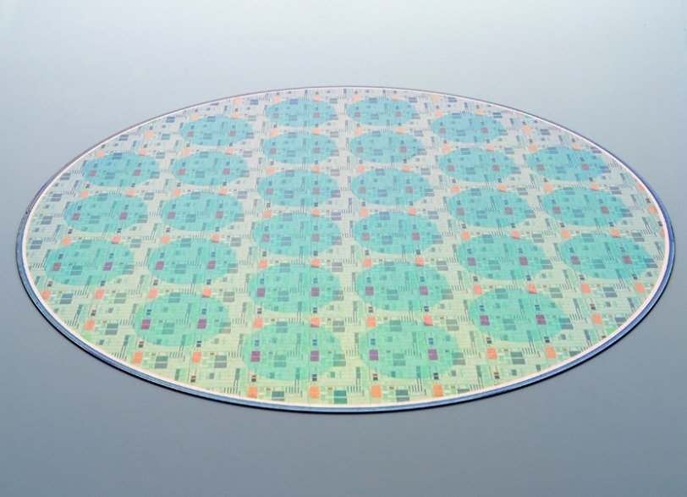
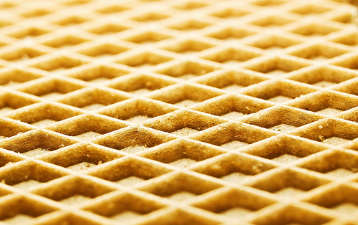
Making MEMS in a clean room
Photolithograpy
  Photo – Light
  Lithography – Excavating (Trenching)
The used of light and chemical bathes to create molds, trenches or structures on Si wafers.

Slide 6
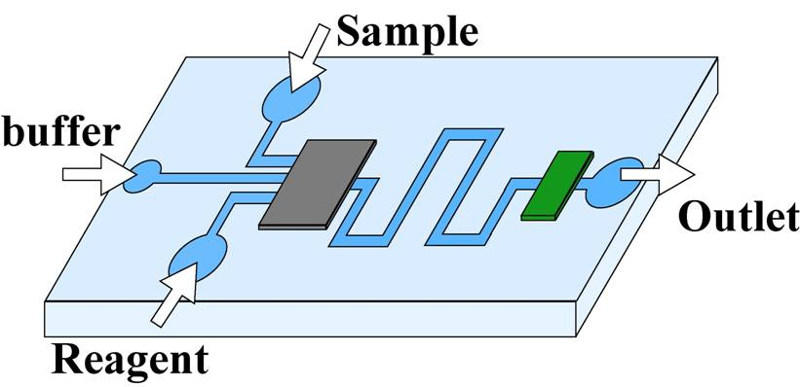
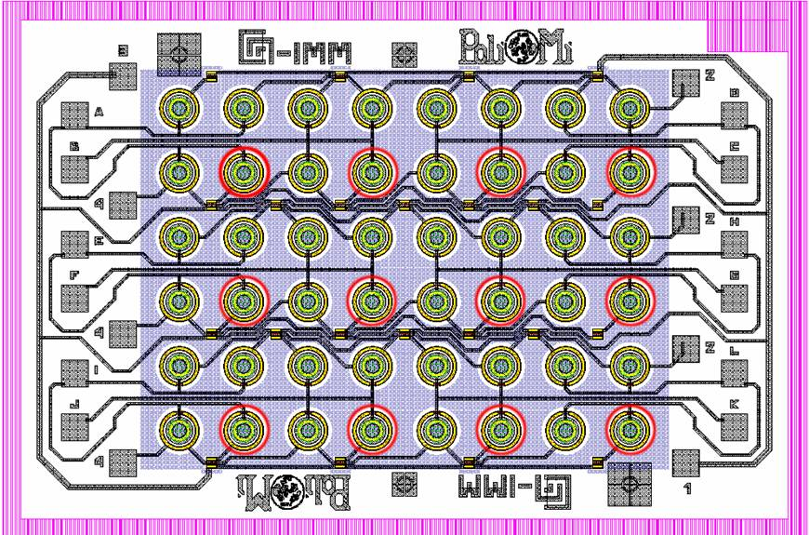
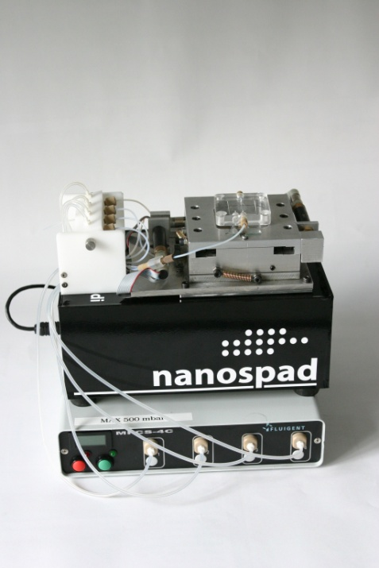
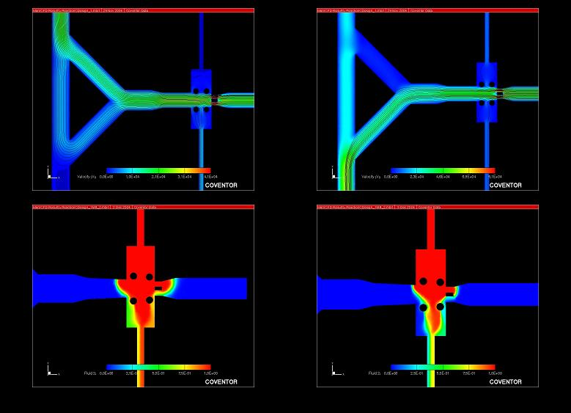
Final Products

Slide 7
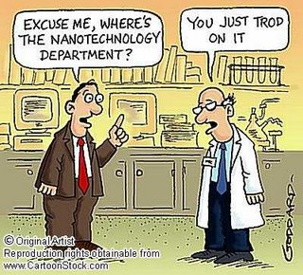
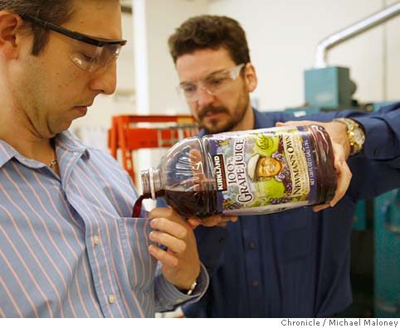
Nanomaterial
Nano – 10⁻⁹ meters
(1/1,000,000 Millimeter)
Example:
  NanoTex
    Titanium Nano particles in the thread
    Microbes can’t survive on Ti
    You can wear this shirt for
    long times without bathing
    and smelling!

Slide 8
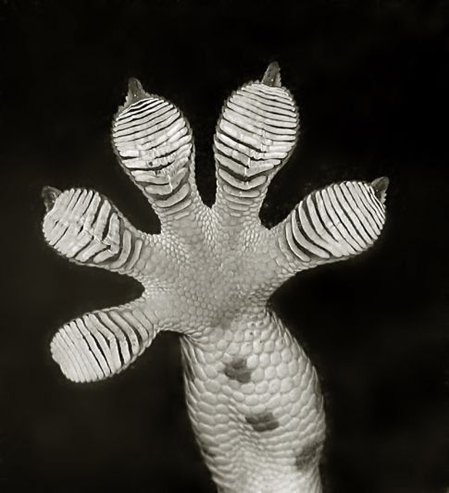
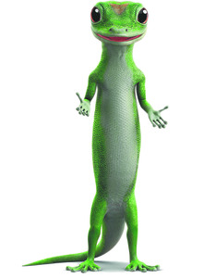
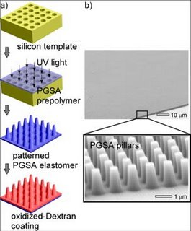
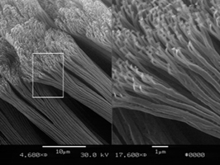
Nano-Animals
Gecko from Geico

Slide 9
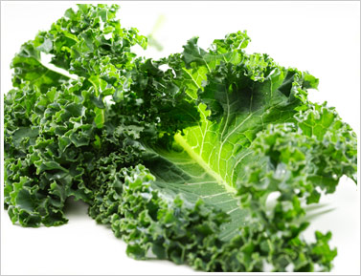
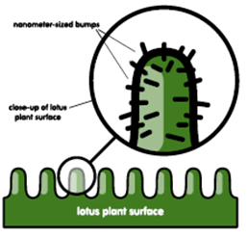
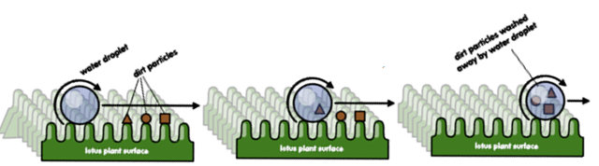
Nano-Plants
Lotus, Kale, Cabbage, etc…
These are self cleaning plants!
BuhGillions of small Nanosized hairs
  These hairs make the surface of the plant hydrophobic (Water Fearing)

Slide 10
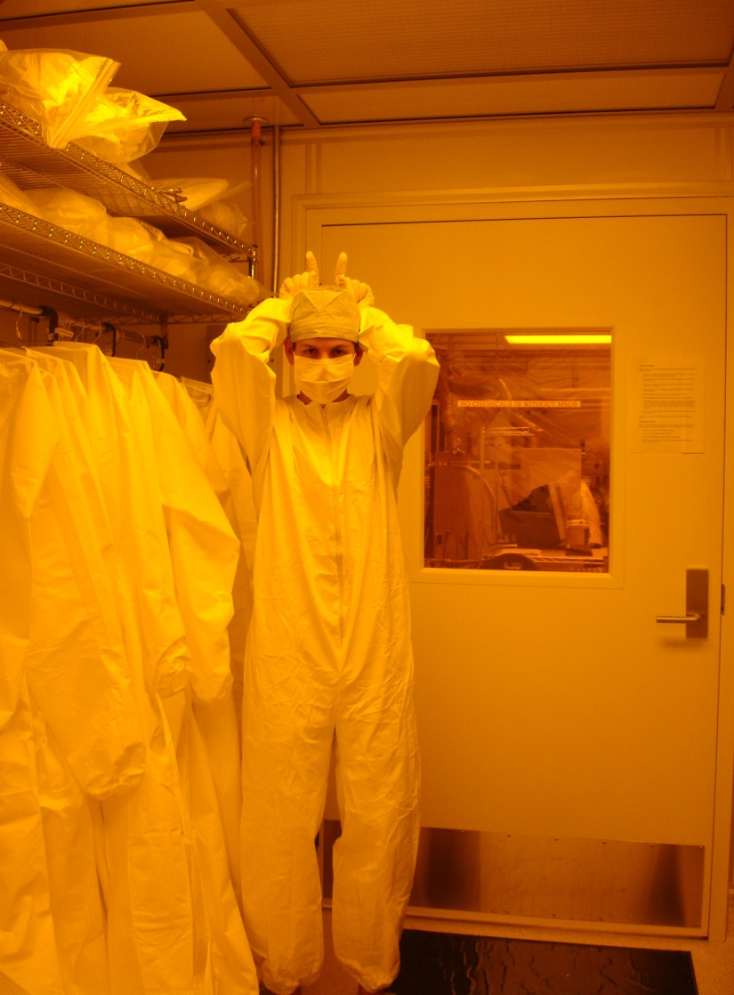
Ryan’s Squishy Science Research
Gels
  Hydrogels
  Suspensions
  Colloids
Smart Materials
  Solubility changing polymers

Slide 11
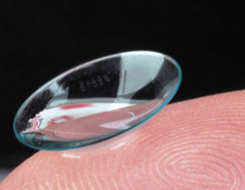
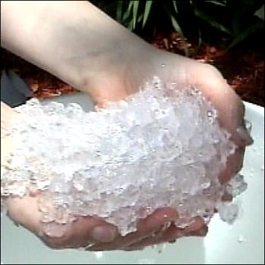
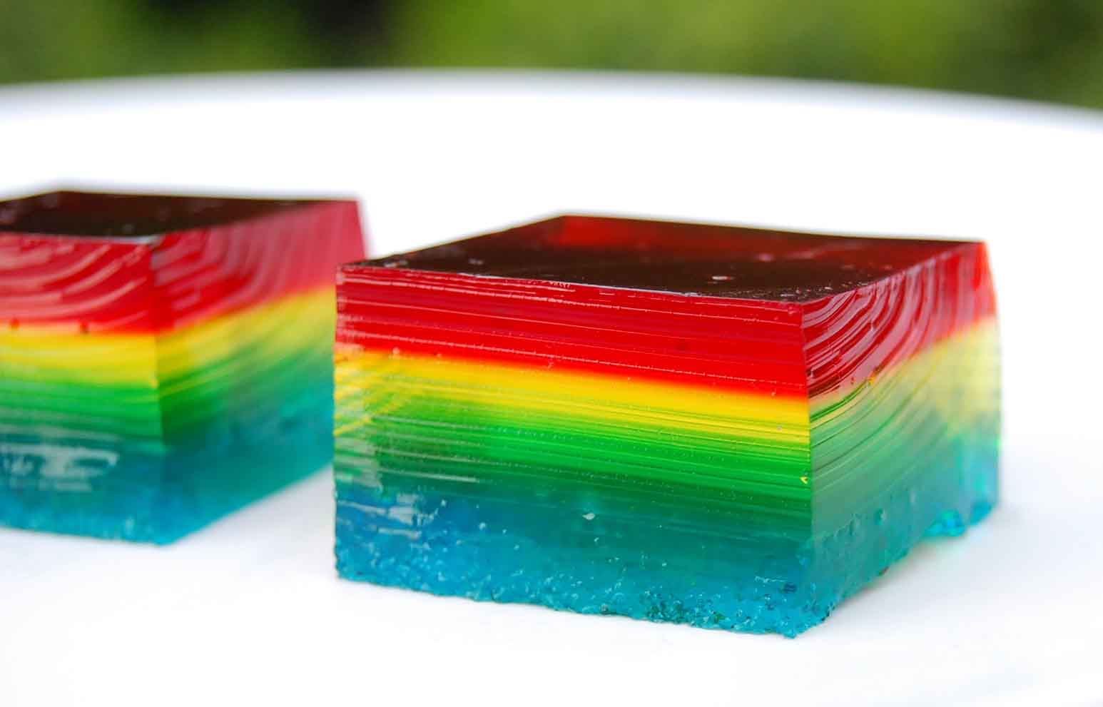
Ryan’s Squishy Gel Research
Hydrogels
  Hydro- water
  Gel- suspension medium
  Like a rubbery maze that
  traps water (like Jell-O!)
  Can be soft and weak or
  hard and tough

Slide 12
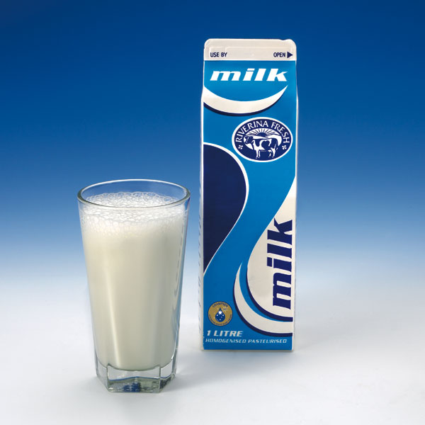
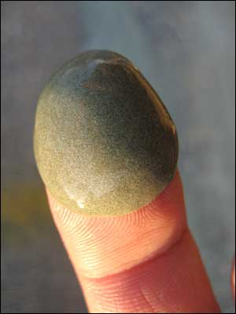
Ryan’s Squishy Gel Research
Suspensions
  Heterogenous Fluids containing solids
Example:
    Milk
    Mud, clay, silt
    Paint
    Dust in air

Slide 13
Ryan’s Squishy Gel Research
Colloids
  chemical mixture where one substance is dispersed evenly throughout another
Example:
    Shaving Cream
    Milk

Slide 14
Ryan’s Squeaky Clean Research
Soaps (aka surfactants or amphiphiles)
  Lower the surface tension of a liquid
  Contain a “Water Loving” and “Water Fearing” end
  Attach to dirt and water
  This is why its important to dry your hands

Slide 15
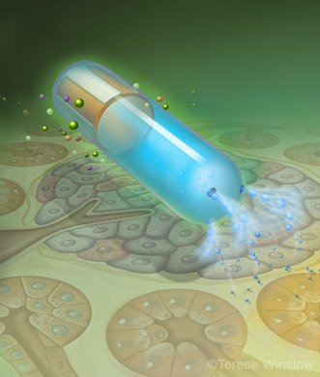
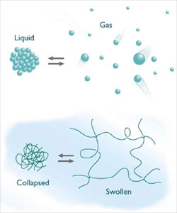
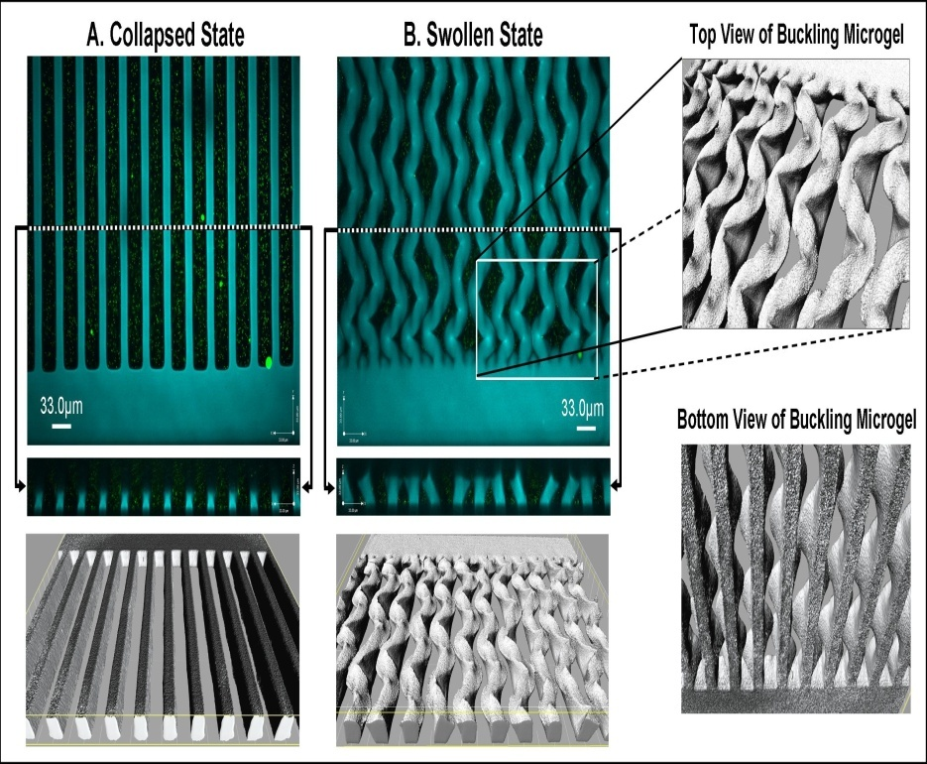
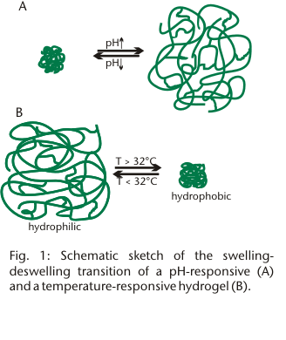
Final Products

Slide 16
Worksheets
If you finish your worksheet early
  Computer Games

